Slide 1
Team 7 – Blindzminder
An energy-saving smart home device
WWCode Hackathon 2018

Slide 2
Problem:
Windows are a major source of heat transfer in and out of the home.
Studies show that closing your blinds at the right time can help to keep your home cool during hot months and warm during cold months
This save energy use, money and helps the comfort of people in the home.

Slide 3
Solution:
The BlindZMinder is a device that will measure ambient light and temperature and close your blinds for you in order to save the most energy.
When the temperature drops, the BlindZMinder will close your blinds automatically, keeping heat energy from escaping on cold days.
When intense direct light is coming through your window, the BlindZMinder will close your blinds to prevent your home from heating up on hot days.

Slide 4
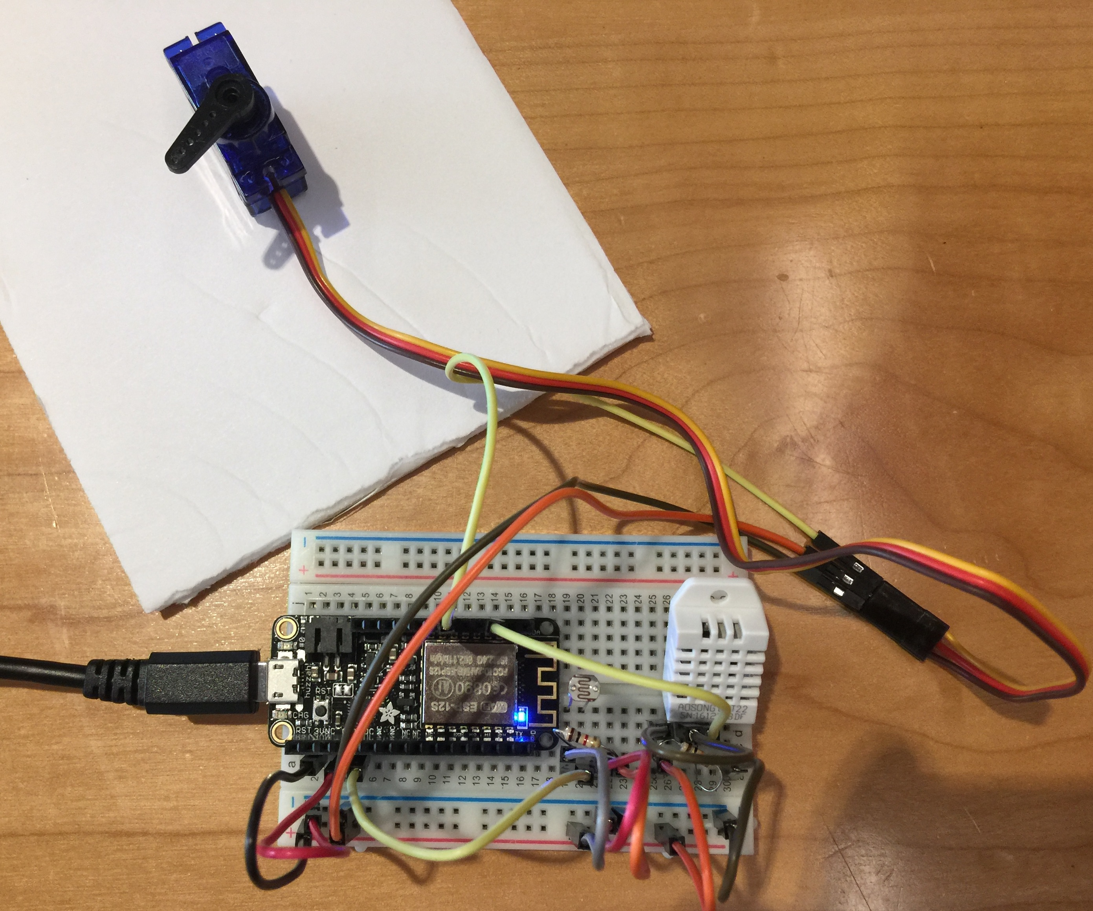

Slide 5
Thank You from the Blindzminder team
- Ann Kasper
- Eric Chunn
- Holly Wilkalis
- Kelly Ogilvie
- Ryan Gergioff
- Shyamal Punekar

